Slide 1
User Interface Design
Dr Simon Lock
simon.lock@bristol.ac.uk

Slide 2
Overview
Most projects will involve some kind of UI (?)
These are often crucial in satisfying the client
Best not to rush head-long into building one
Better to use some design principles & tools to help

Slide 3
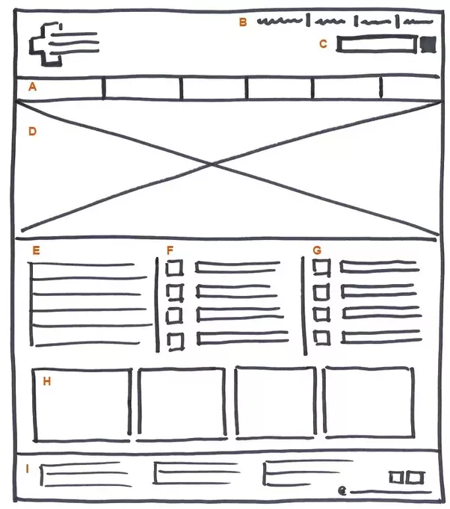
Page Schematic (aka “wireframe”)

Slide 4
Benefits and Limitation of Wireframes
Page Schematics are a simple but useful tool
Everyone can sit round and discuss them
Make suggestions and change things
The problem is that they are static
You can't see dynamic aspects of interface
What happens when the user interacts ?

Slide 5
Paper Prototypes
A more dynamic approach is a “paper prototype”
Seems silly at first, but can save much time later on
Involves creating screens, dialogs, widgets etc.
Using card, blu-tack, post-it notes, pens, paper
We can “act out” interaction with the system
We can even video the results for later use…

Slide 6
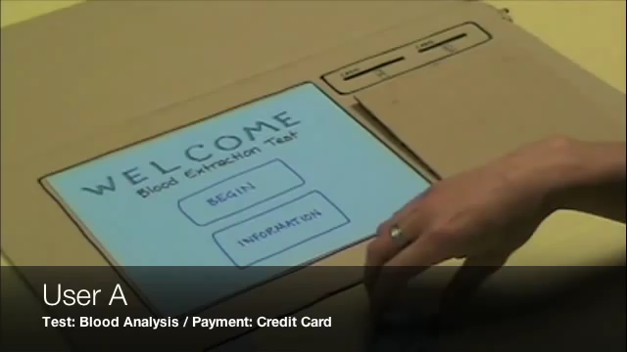

Slide 7
Ultimate Evolution
Perhaps the masters of the "paper prototype" video is the "In Plain English" group:
https://www.youtube.com/watch?v=eRqUE6IHTEA

Slide 8
Abstract Design Heuristics
Would be nice to have some advice on UI design !
Various people have proposed design “heuristics”
Lists of aspirational "good things to do"
Often are very abstract and high level
Illustrate "an attitude towards doing things"
Most famous is Nielsen's Heuristics…

Slide 9
Nielsen’s Heuristics
Use simple and natural dialogue
Speak the user's language
Minimise the user's memory load
Be consistent
Provide feedback
Clearly mark exits
Provide shortcuts
Use good error messages
Try to prevent user errors
Integrate help and documentation
Which is most useful
(to your project) ?

Slide 10
Concrete Guidelines
Due to their abstractness, heuristics can often be hard to apply directly to a project
“Be consistent” is always a good idea, but how ?
Luckily, there are sets of much more applicable "concrete guidelines" that can help
These are often derived from abstract heuristics…
But also informed by real world dev. practice

Slide 11
Nielsen and Loranger
Nielsen has collaborated with a colleague to develop just such as list of guidelines
These are aimed at website design, but are generally applicable to other types of application
Although some are still a bit abstract and hard to apply, there is plenty of good specific advice

Slide 12
N&L: Navigation
Match structure to user expectations
Be consistent with navigation mechanism
Beware the "coolness" factor in navigation
Reduce clutter and redundancy
Be specific with link text and label names
Avoid long dropdown menus
Minimize multi-level menus
Make sure it is clear what you can click on
Clicking (next) can be faster than scrolling
Direct links to a few key features on main page

Slide 13
N&L: Typography
Use common fonts sized 10 points or larger
Watch out for fonts that look small at 10 point
Use typefaces & styles sparingly + consistently
Avoid busy backgrounds
Use dark text on light backgrounds (or vice versa)
Avoid anti-alias fonts
Keep all-capital and image text to minimum
Avoid moving and blinking text

Slide 14
N&L: Formatting
Highlight keywords
Use concise, descriptive titles and headings
Use bullet lists and numbered steps
Keep paragraphs short
Present most important info in first two lines

Slide 15
N&L: Layout
Treat "3 click rule" with caution
Prioritise order of page content
Group related content in close proximity
Don't require unnecessary user interaction
Align elements to create order
Position elements where people expect them
Don't try to cram in too much content
Include suitably located whitespace

Slide 16
Rookie Mistakes (anti-heuristics)
Breaking the "back" button
Over use of pop-ups
Too much textual content (TL:DR)
Things that look like links, but aren't !
Things that don't look like links, but are !!!
Fancy drop-down menus
(that aren't device independent)
Requiring users to register
(when they don't really need to)

Slide 17
Layout Templates
Layout templates can be very helpful
Speed things up by providing a good starting point
You can use them as inspiration for your layouts
Or actually copy the code into your projects
Pros and cons for each of these approaches !

Slide 18
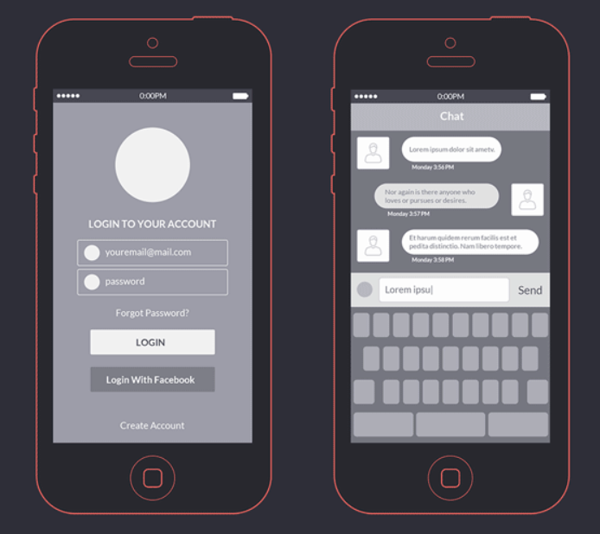

Slide 19
Templates Kits
There are lots of different resources are available
Here a just a couple of examples:
www.cssauthor.com/mobile-wireframe-kit-psd
graphicburger.com/app-wireframes-kit
speckyboy.com/free-wireframe-templates-mobile-app-web-ux-design/

Slide 20
Building Interfaces
We can only put it off for so long !
At some point you are actually going to have to build some user interface pages/screens/layouts
Some people advocate doing everything by hand
(using a text editor to manually edit code/XML)
Others prefer to use higher level tools…

Slide 21
GUI Builders
Android Studio Layout Editor
Fluid UI
DroidDraw
Ionic Creator
Adobe Dreamweaver
JetStrap
LayoutIt!
Bootstrap Studio

Slide 22
Similarities
Typically these tools work in a very similar manner:
Visual representation of user interface
Palette of interface widgets/components/controls
Drag & drop elements onto interface
Apply (annoyingly hard to control) layout tools :o)
Switch to “code view” to manually tweak GUI
Break the whole thing, have to start again :o(

Slide 23
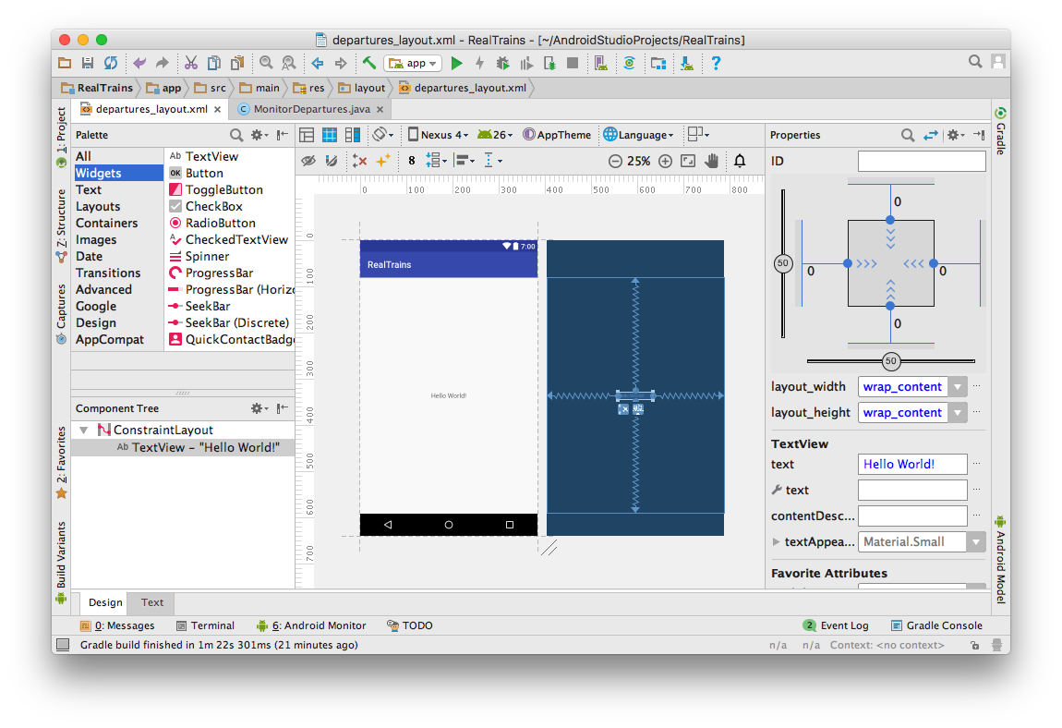
Android Studio Layout Editor

Slide 24
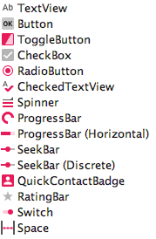
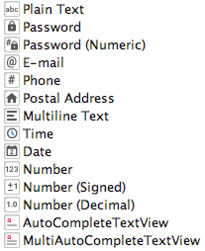
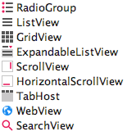
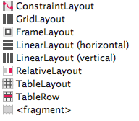


Palette

Slide 25
Widget Layout
Laying out widgets is a tricky job…
We shouldn’t just fix size/position absolutely (x,y)
Dimensions should vary depending on screen res !
Instead we use a layout manager to do the work
Each manager has a set of layout rules
They use these to decide where to put a widget
And how big to make it

Slide 26
Constraint Layout
Typical example of a layout manager
Gives you some say in the laying out of widgets
But at the end of the day, does it’s own thing ;o)
Lets you choose between following mechanisms:
Wrapped
Sprung
Proportional
Let’s take a look at each of these in more detail…

Slide 27
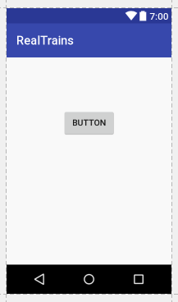
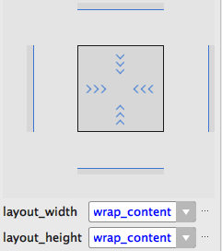
Constraint Layout: Wrap to Content

Slide 28
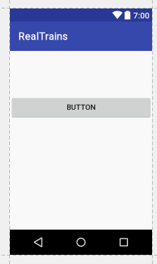
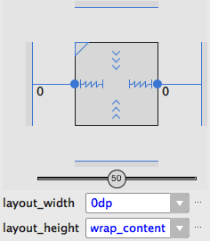
Constraint Layout: Fully Sprung

Slide 29
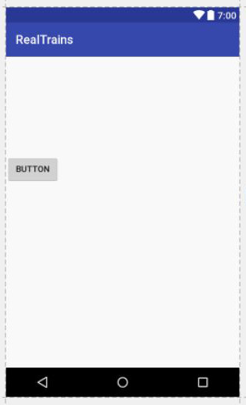
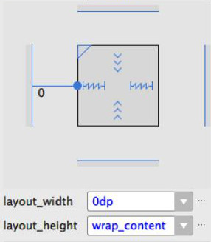
Constraint Layout: One Side Sprung

Slide 30
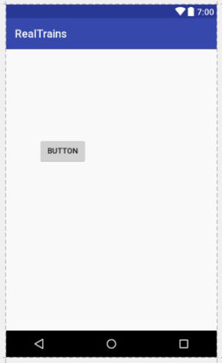
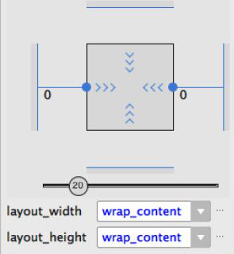
Constraint Layout: Proportional Position

Slide 31
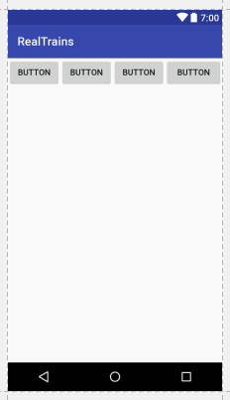
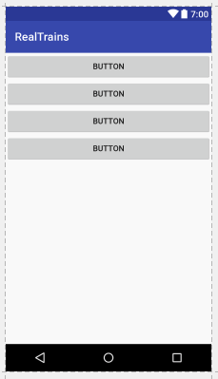
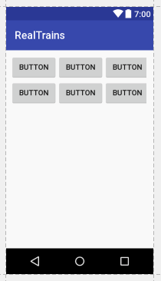
Collections
Linear Horizontal
Linear Vertical
Grid Layout

Slide 32
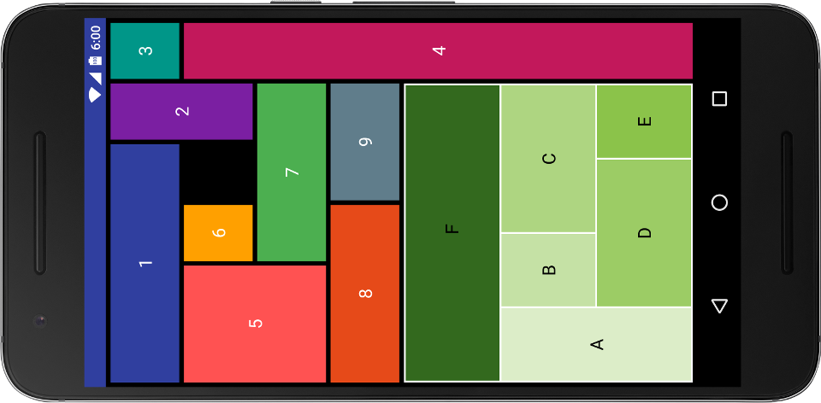
Nesting

Slide 33
Getting Frustrated ?
Can’t achieve something easily ?
Chances are you shouldn't be trying to do it !
“How can I make this button full width of screen ?”
Is it going to look OK full width on a tablet ?
Being responsive and looking good on all screens is a hard (impossible ?) balance to achieve.
You might have to learn to live with compromise

Slide 34
GUI builders versus hand crafting
As with any “intelligent” editor…
You can get something up & running very quickly
Save a lot of time learning the code/markup
It’s not all good news though :o(
Can add a lot of unnecessary (hard to read) code
Makes things tricky when something goes wrong !
The choice is yours :o)

